Slide 1










Sexual Health Board Report
July 2024
@myhqtoronto | hqtoronto.ca | hqtoronto.ca/donate

Slide 2
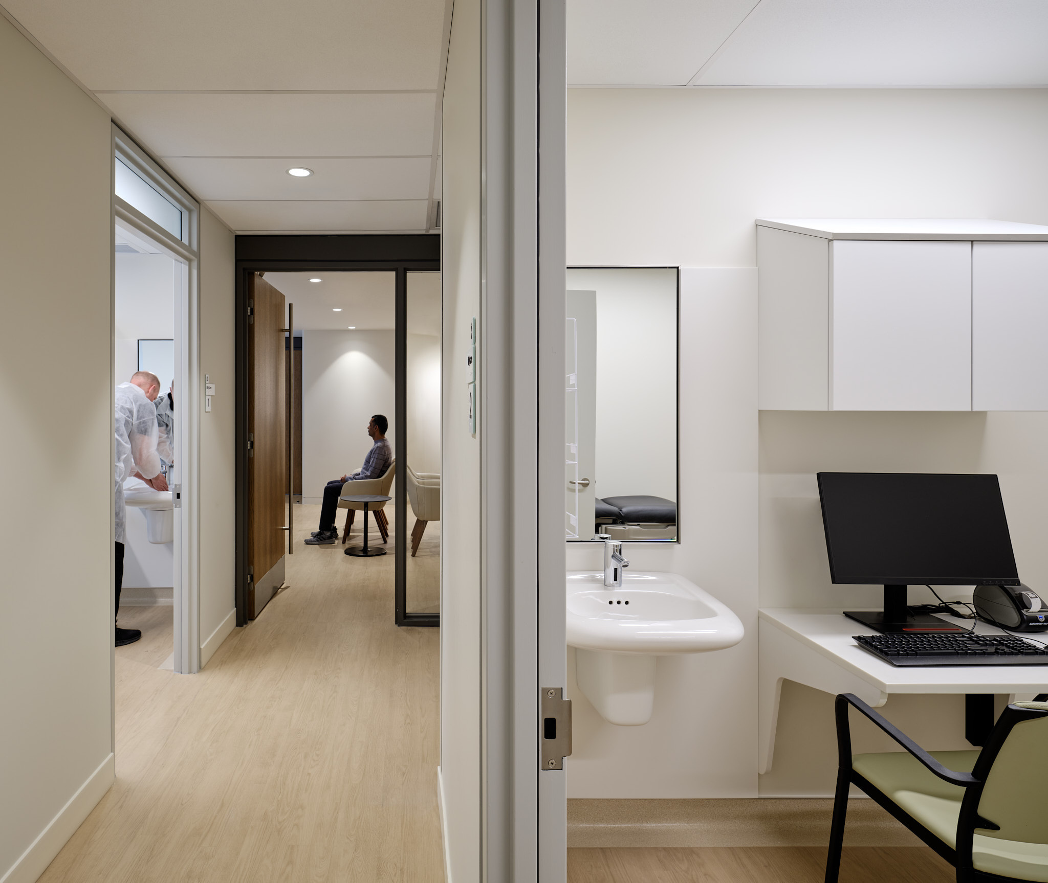
Sexual Health
Key Messages
July 2024
Highest weekly average last week
178 sexual health visits / day
Highest number of daily service users on Monday July 8, 2024 at 220 users
New visits have stabilized.
Our testing is significantly less expensive than Public Health.
Successful Code for Canada Hackathon
Idea 1:
Improve kiosk check-in process
Idea 2:
Automate mass sending of all negative results (80% of patients)
@myhqtoronto | hqtoronto.ca | hqtoronto.ca/donate

Slide 4

The problem
How might we make it easier for HQ Toronto patients to know where they are in the check-in and triage process so that they feel more informed?

Slide 6

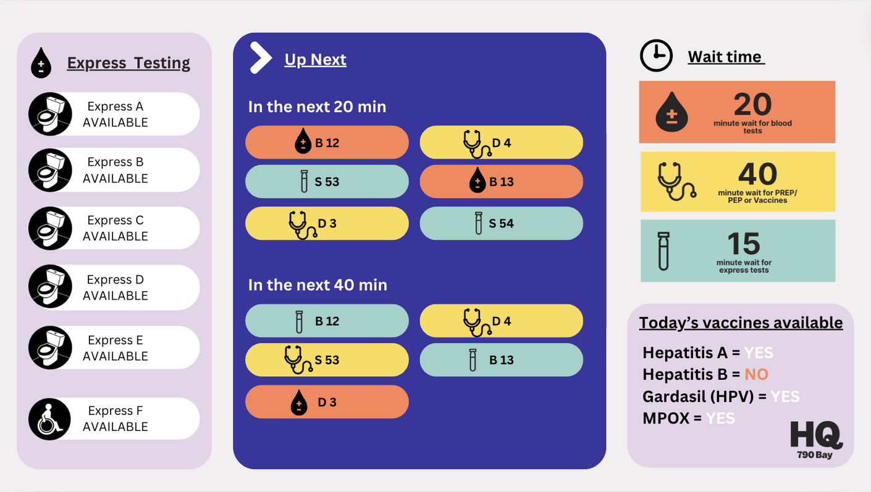
V4

Slide 7
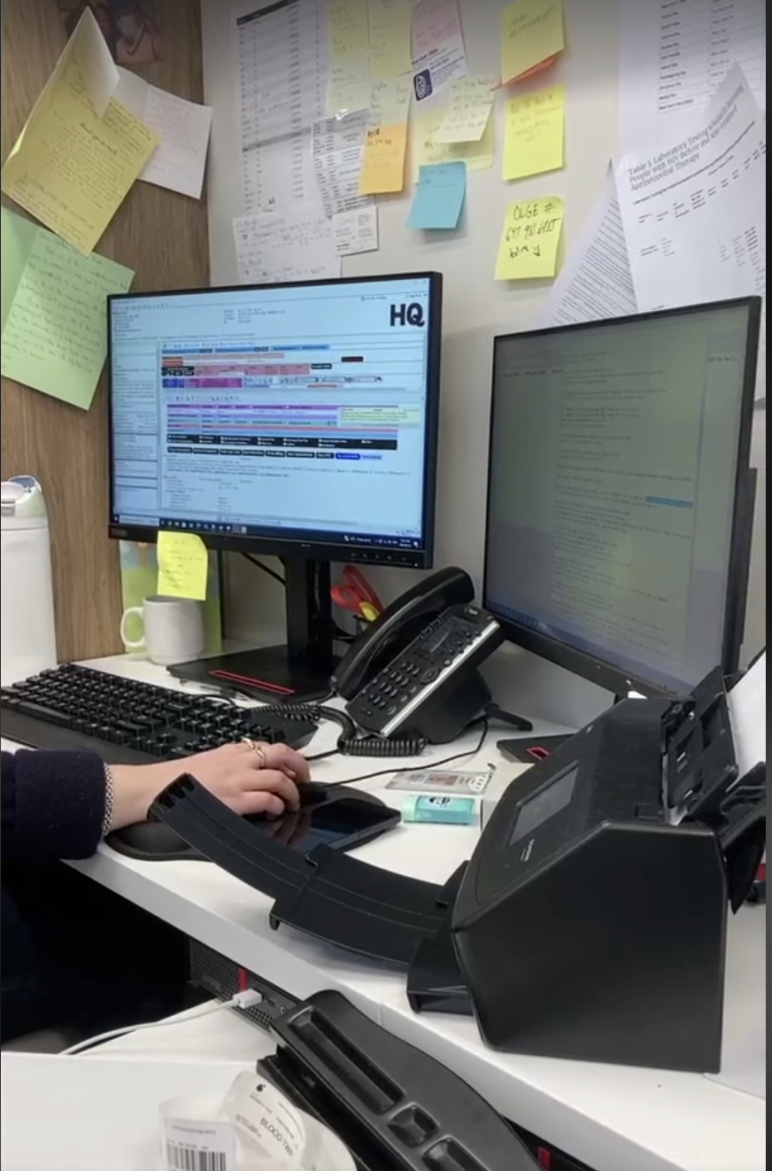

The problem
What is the problem?
Tasks nurses spend a lot of time sending negative test results to patients, which could be better used for delivering care to patients.
Why is this important?
Lead to increased employee burnout
Reduced patient care
Results not shared quickly
Reduced level of patient care

Slide 8
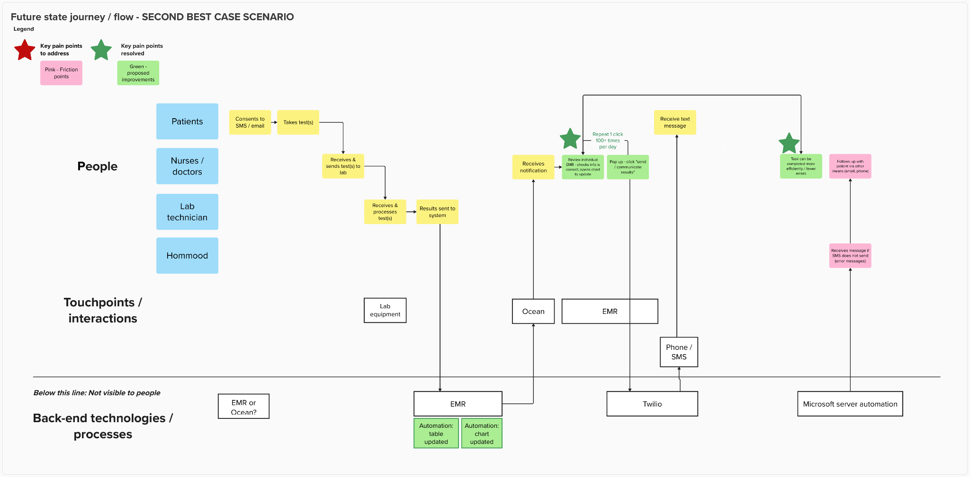
Future state: Texting a negative test result

Slide 9
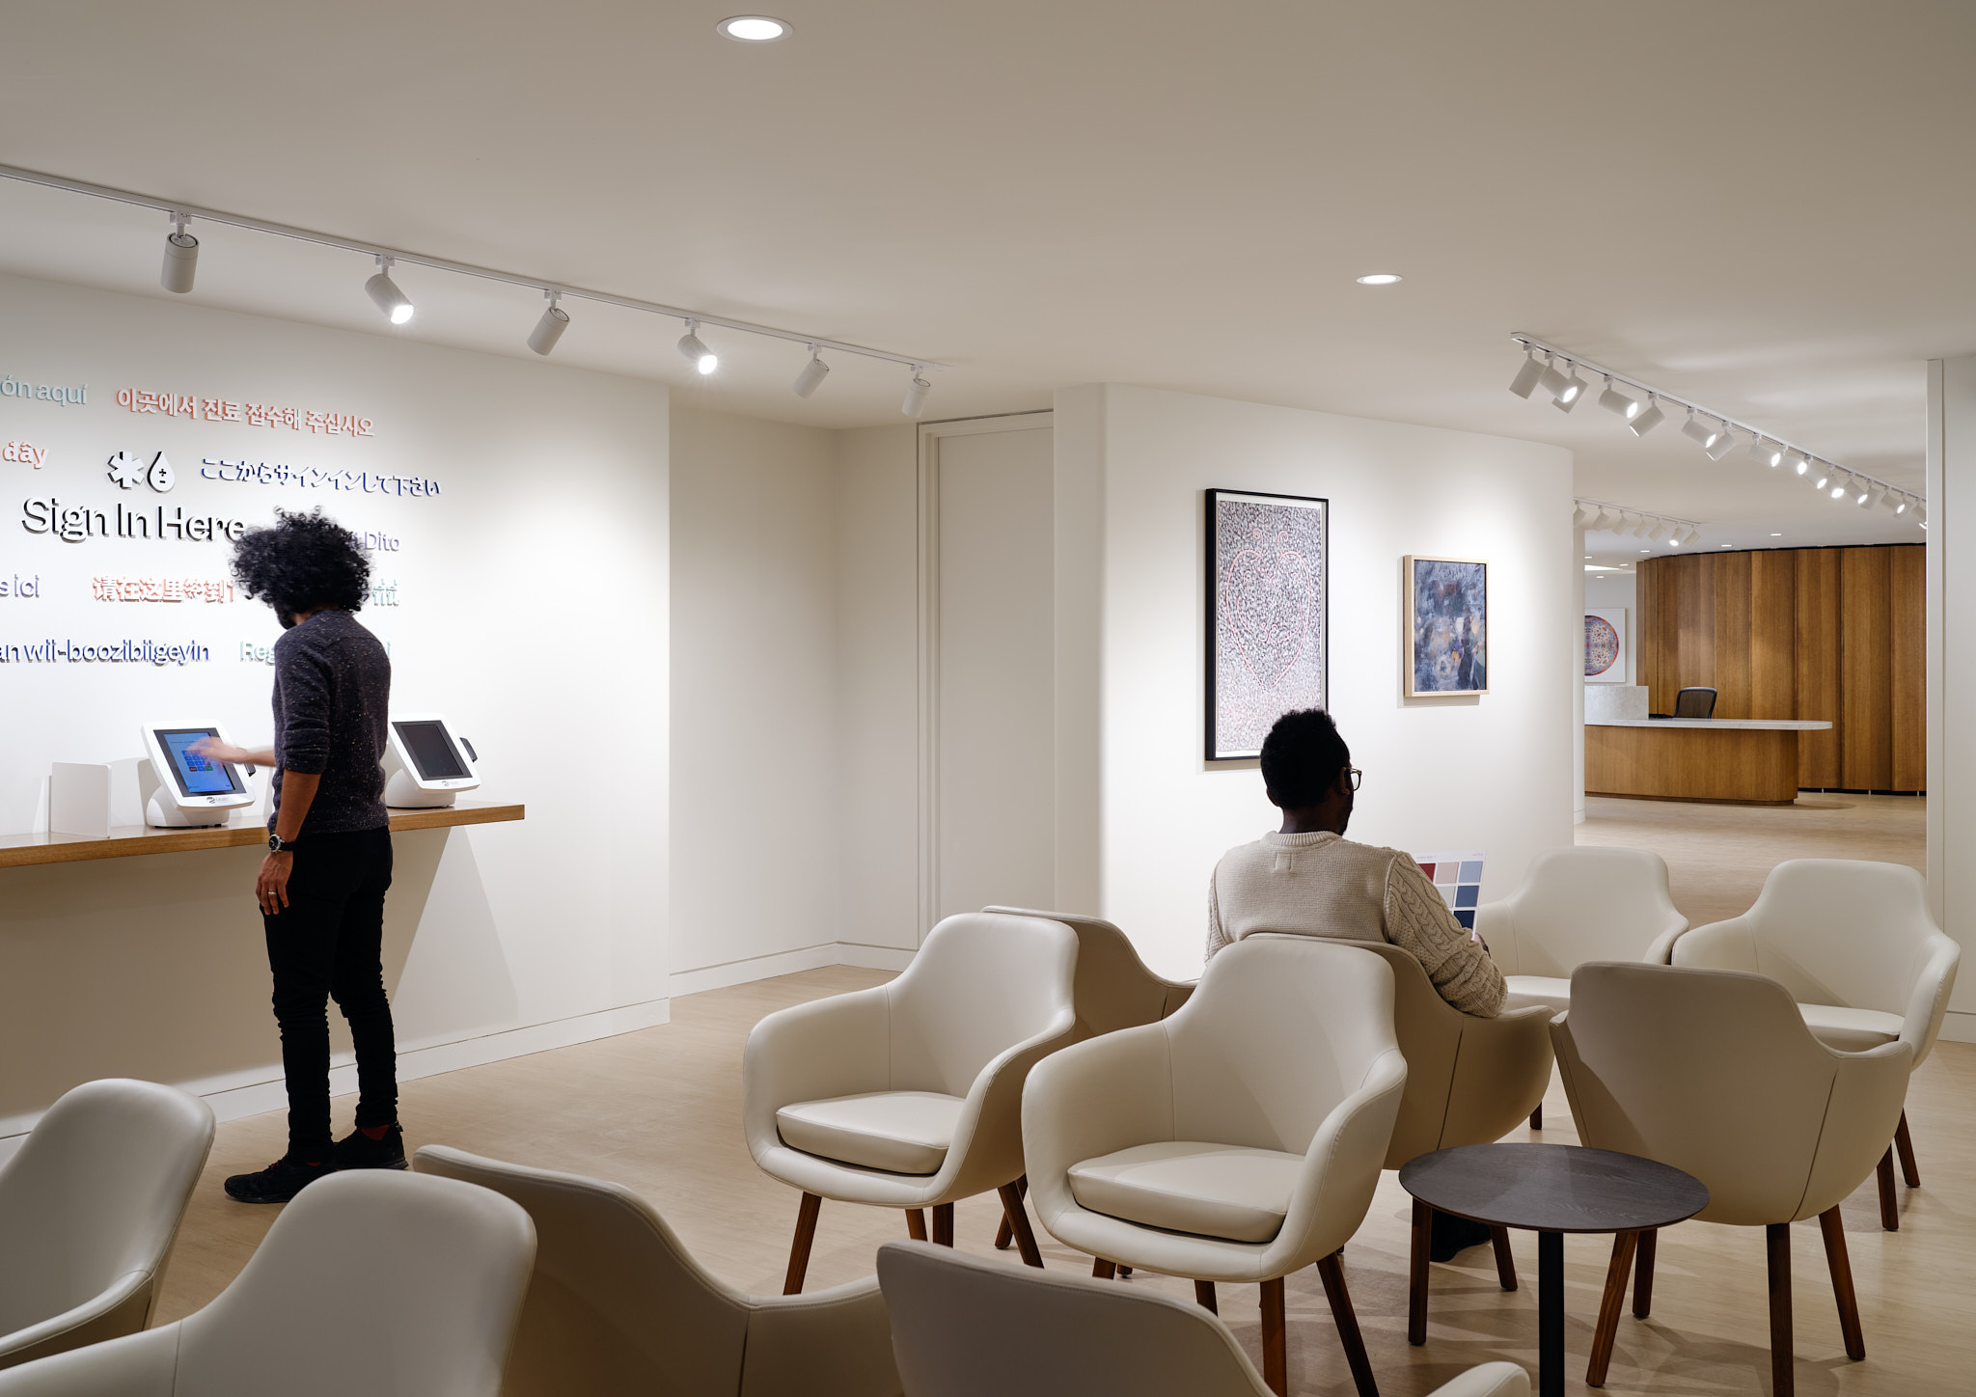
Cumulative data on sexual health visit from July 2022 to June 2024
50, 736 visits
12,246 individuals
@myhqtoronto | hqtoronto.ca | hqtoronto.ca/donate

Slide 10
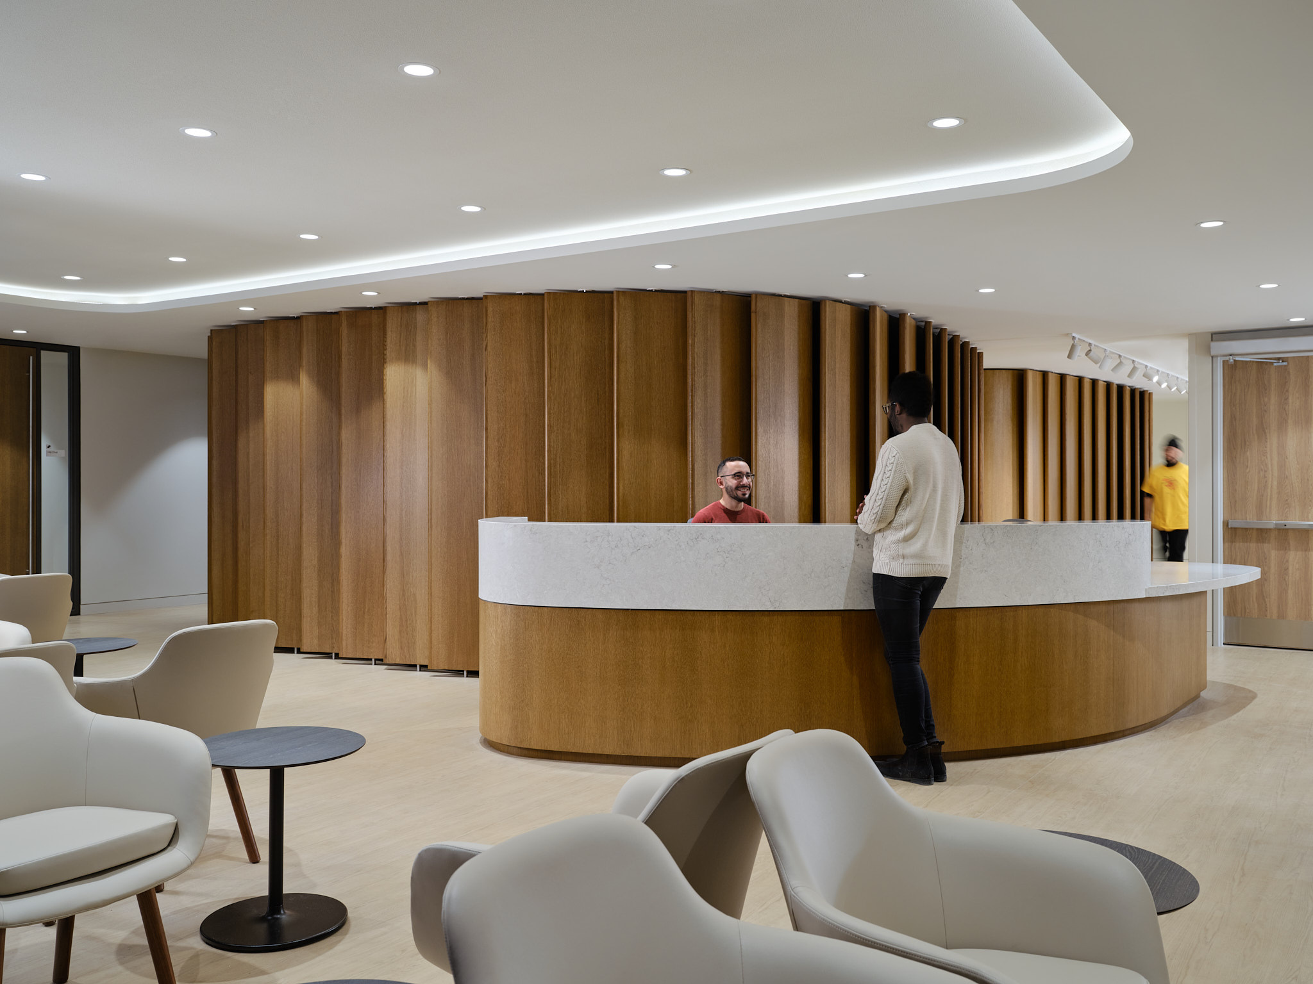
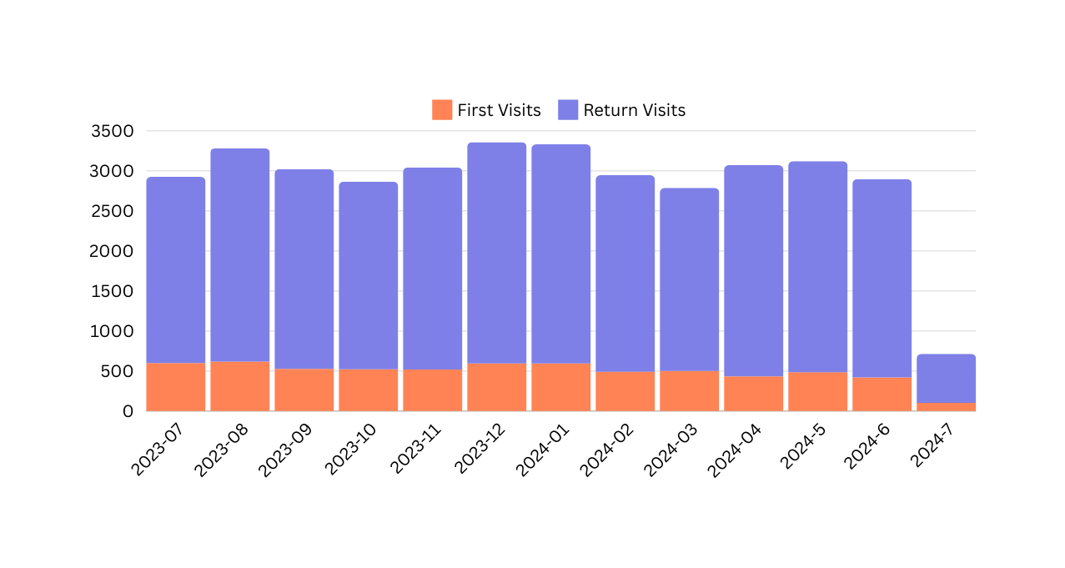
First vs Return
July 2023 - June 2024
04,725 visits in 2022
27,025 visits in 2023
18,986 visits in 2024
@myhqtoronto | hqtoronto.ca | hqtoronto.ca/donate

Slide 11
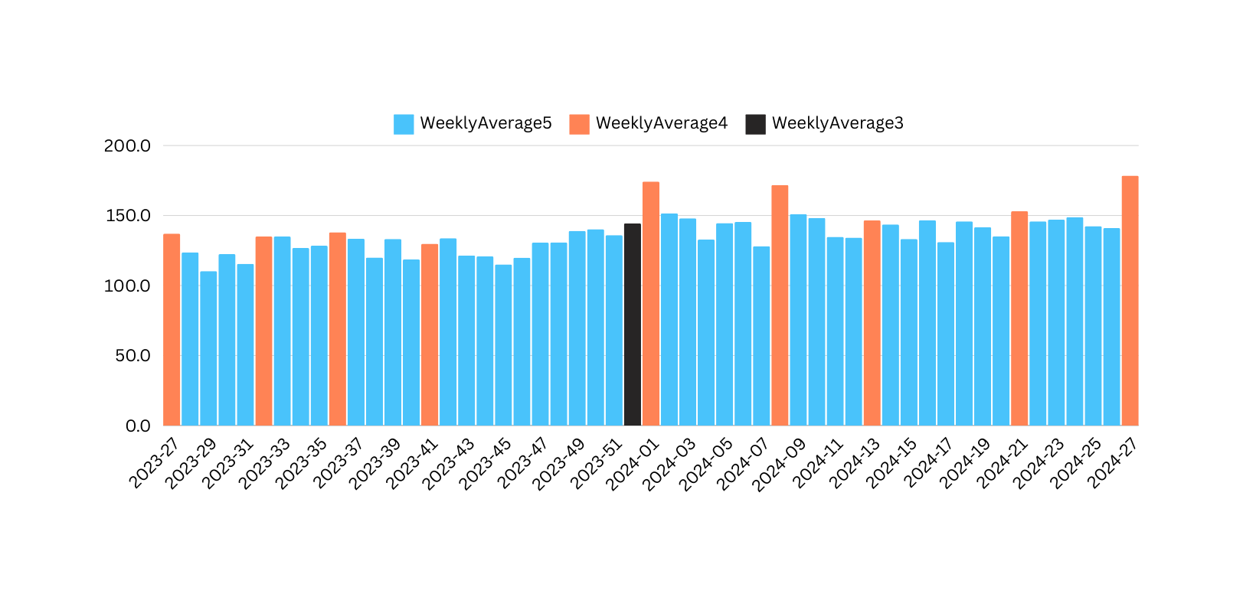
Average Weekly
July 2023 - June 2024
Christmas / Boxing Day
Canada Day
Civic Holiday
Labour Day
Thanksgiving
New Year
Family Day
Good Friday
Victoria Day
Canada Day
@myhqtoronto | hqtoronto.ca | hqtoronto.ca/donate

Slide 12






Demographics
July 2022 to
June 2024
Average age of 34
10% living with HIV
Cis men: 87%
Trans men: 0.9%
Trans women: 1.4%
Non binary: 5.6%
Other gender identity : 1.5%
@myhqtoronto | hqtoronto.ca | hqtoronto.ca/donate

Slide 13

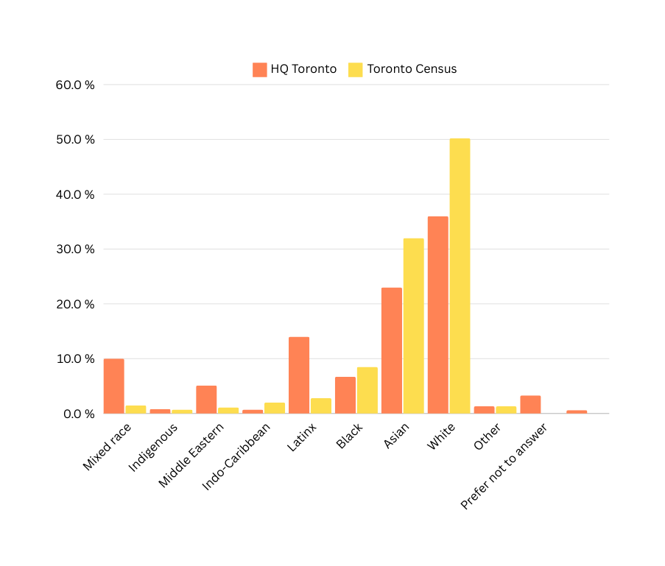
Ethnicity by individuals
July 2022 to June 2024
@myhqtoronto | hqtoronto.ca | hqtoronto.ca/donate

Slide 14
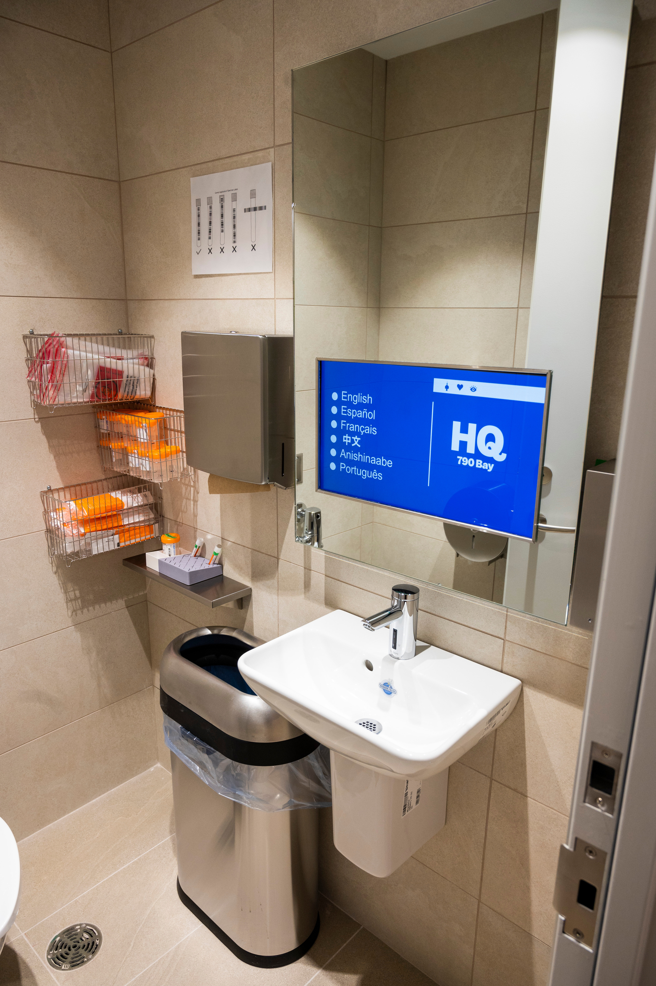
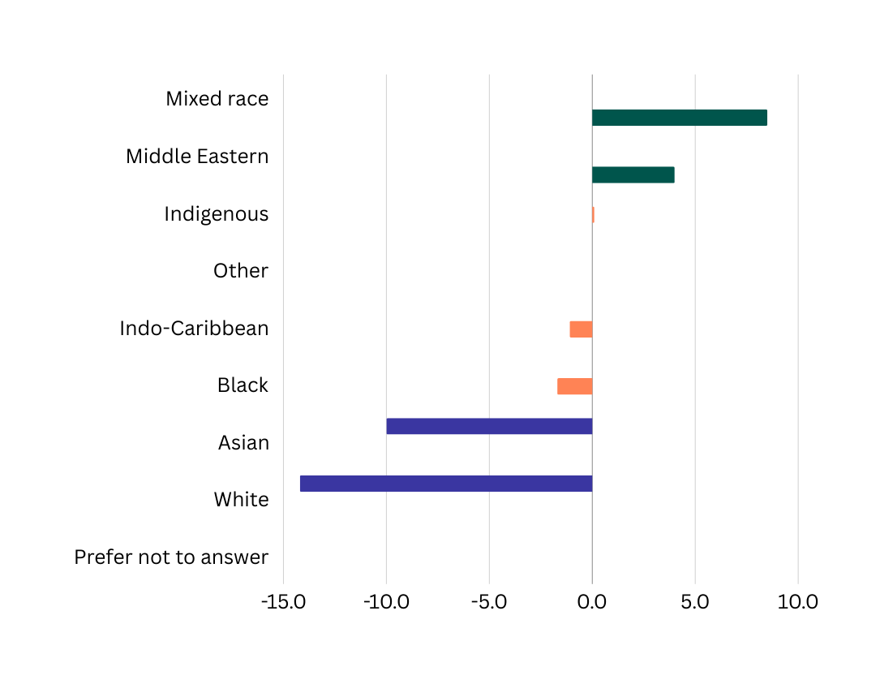
Ethnicity
(Difference between Toronto 2020 Census and HQ
<Toronto Census
= Toronto Census
> Toronto Census
@myhqtoronto | hqtoronto.ca | hqtoronto.ca/donate

Slide 15
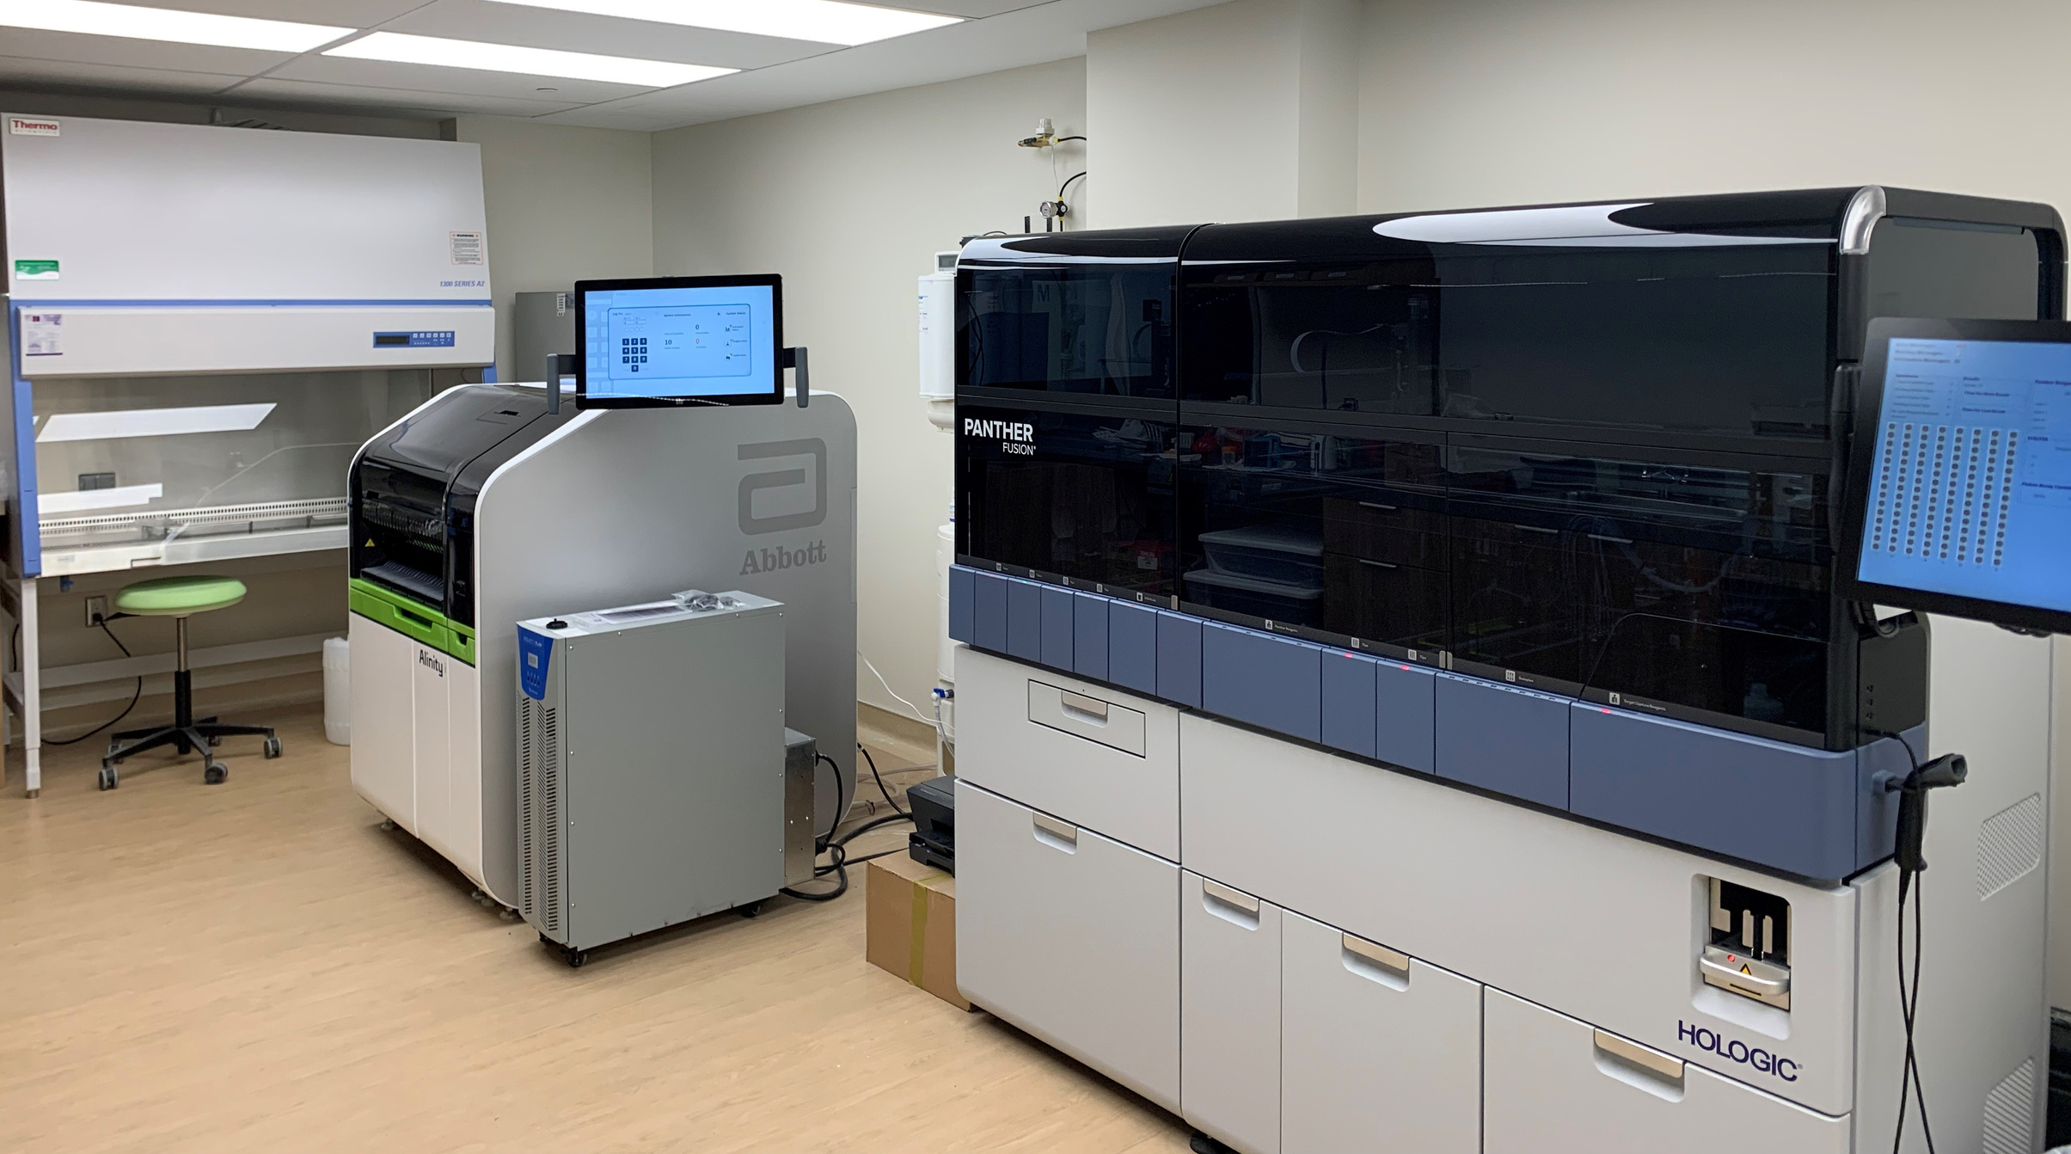
Improving the Health of Our Community
239,720 Test results
39,234 Treatment
@myhqtoronto | hqtoronto.ca | hqtoronto.ca/donate

Slide 16
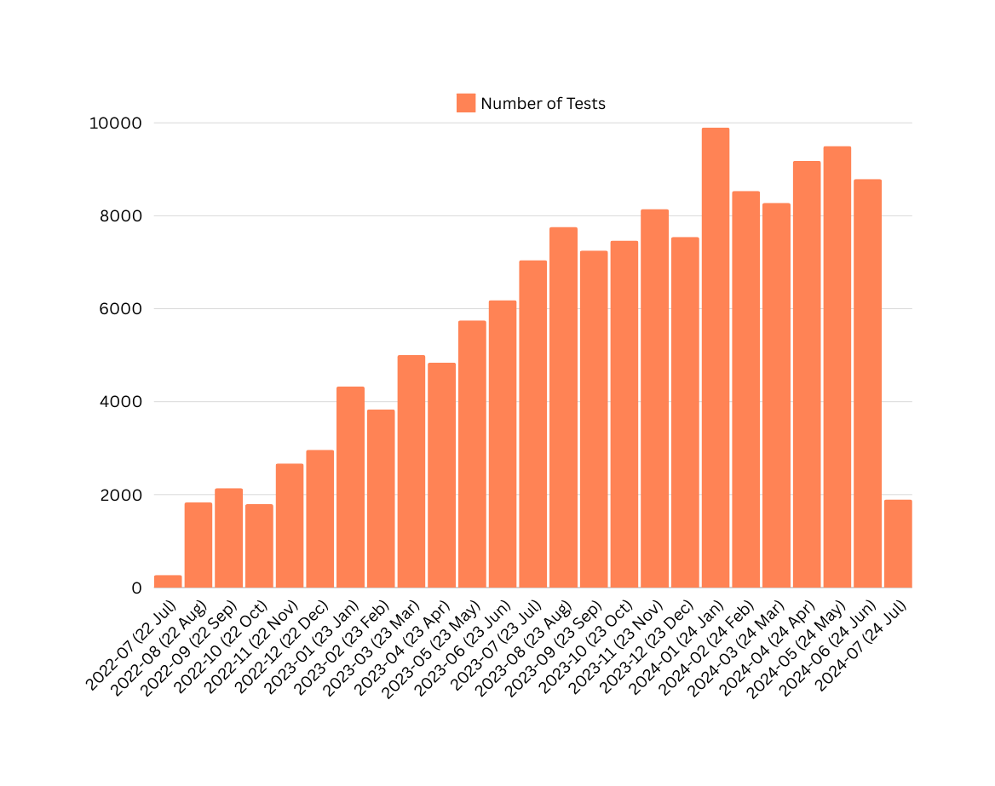
STBBI Testing- Overall
Overall Numbers
@myhqtoronto | hqtoronto.ca | hqtoronto.ca/donate

Slide 17
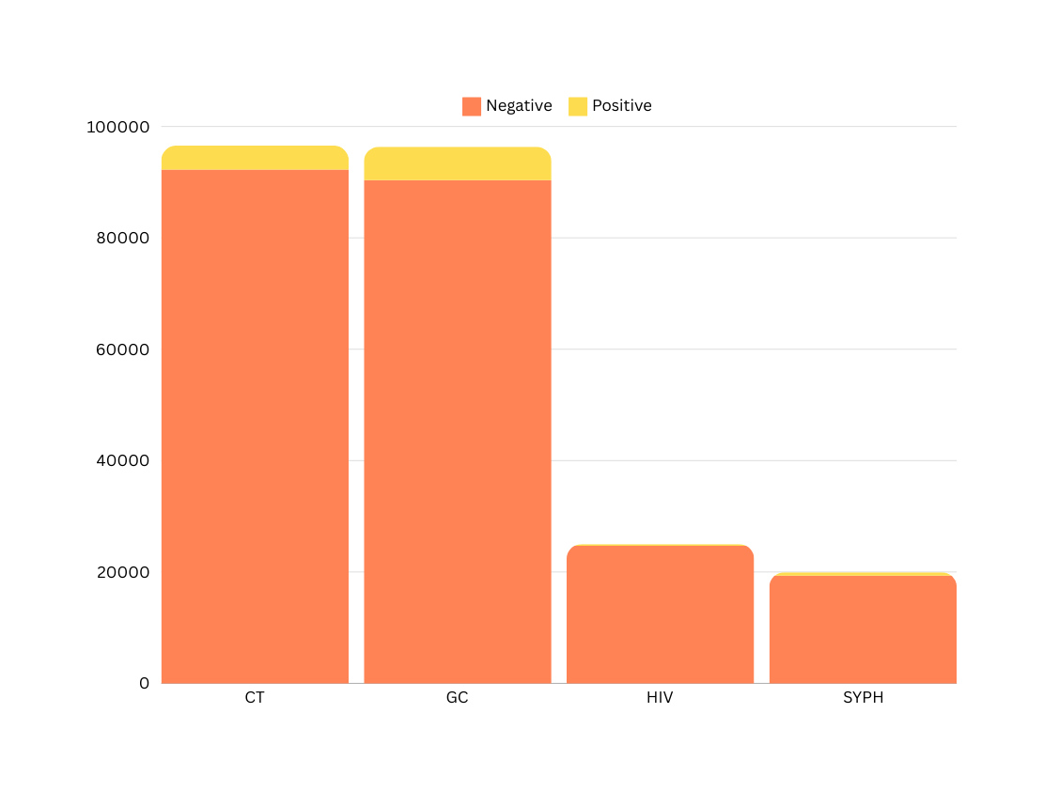
STBBI Testing
4303
6017
318
606
@myhqtoronto | hqtoronto.ca | hqtoronto.ca/donate

Slide 18
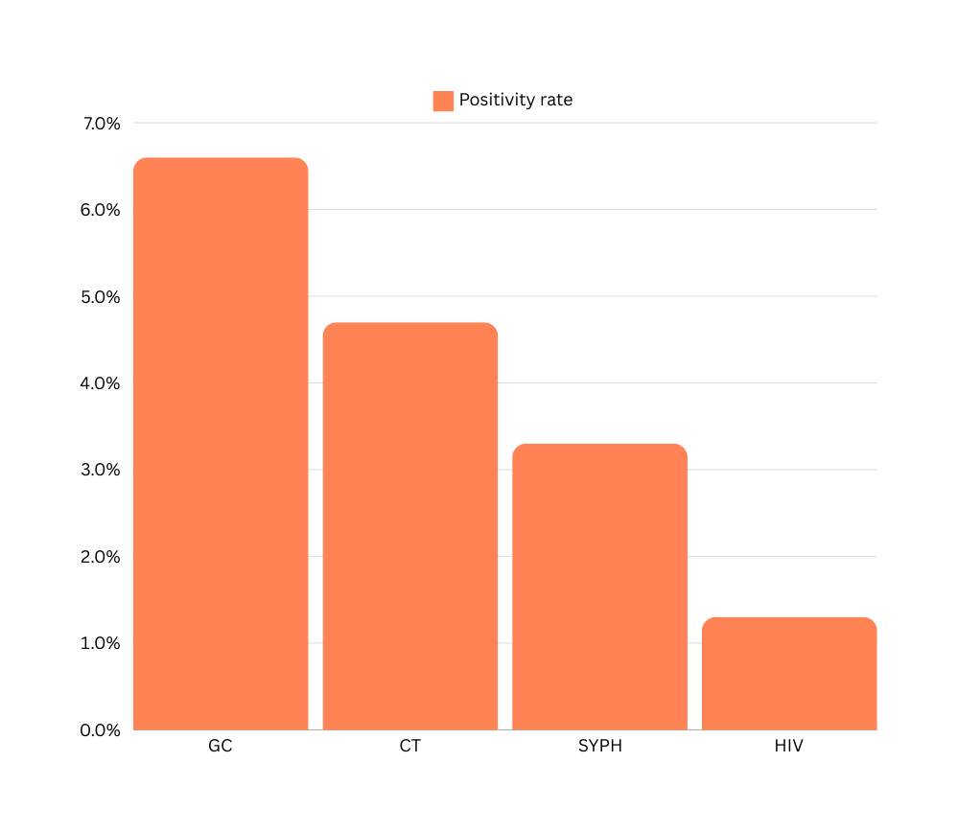
Positivity Rate
July 2022-June 2024
6.2%
4.5%
3.0%
1.3%
@myhqtoronto | hqtoronto.ca | hqtoronto.ca/donate

Slide 19
June 2024
Per Test Cost
 | Cost / Test | Test Volumes | Labour cost / Test | July Total Cost / Test
HIV Ag/Ab Combo Assay | $1.85 | 1618 | $ 2.39 | $ 4.24
Syphilis TP Assay | $ 1.34 | 1293 | $ 2.39 | $ 3.73
Aptima Combo 2 | $9.50 | 5868 | $ 2.39 | $ 11.89
HIV-1 QuantDx | $25.00 | 12 | $ 2.39 | $ 27.39
@myhqtoronto | hqtoronto.ca | hqtoronto.ca/donate

Slide 20
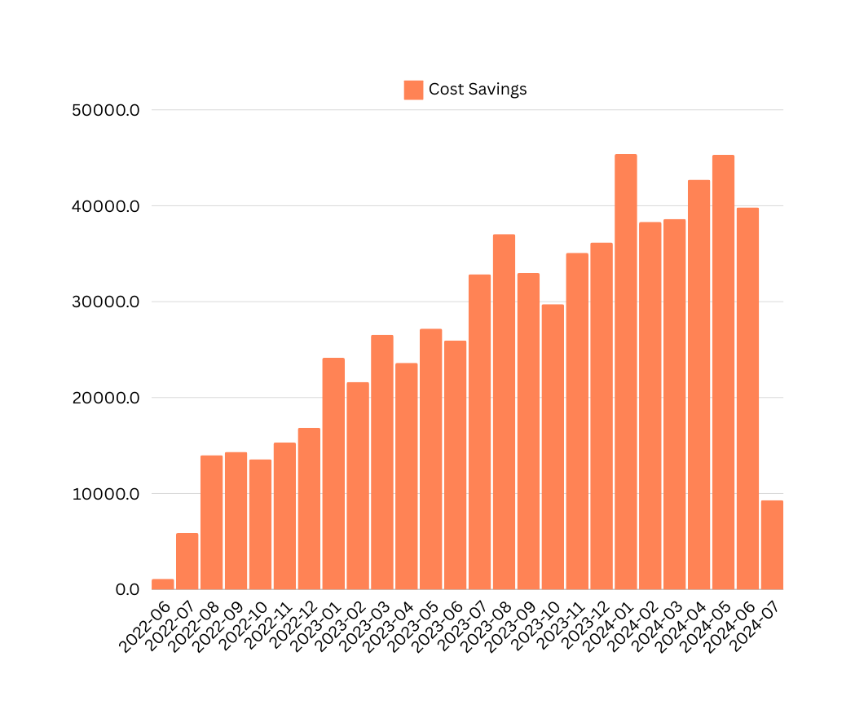
Monthly Cost Savings from Express Testing
Total cumulative savings to-date
$538,282
@myhqtoronto | hqtoronto.ca | hqtoronto.ca/donate

Slide 21

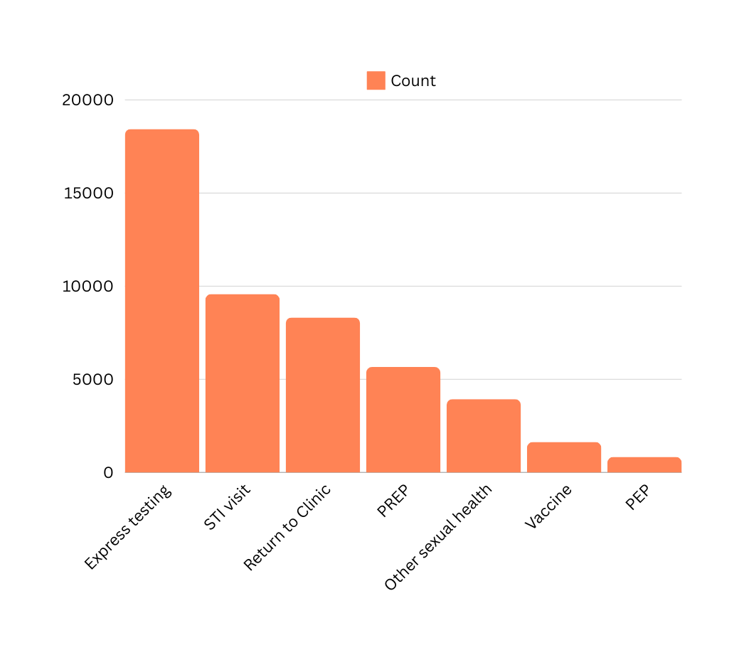
Reasons for Visit
July 2022 - June 2024
What individuals indicate on the kiosk as the reason for their visit
@myhqtoronto | hqtoronto.ca | hqtoronto.ca/donate

Slide 22

Unmet STBBI Needs
July 2022 - June 2024
2150 uninsured or precariously insured individuals accessing care at HQ (no OHIP or IFH)
2028 STBBIs diagnosed and treated amongst uninsured individuals
1321 gonorrhea or chlamydia
604 syphilis
2770 treatments given to 1212 service users (includes empiric treatments)
@myhqtoronto | hqtoronto.ca | hqtoronto.ca/donate

Slide 23


330 individuals with no OHIP, living with HIV receiving their HIV care at HQ
Unmet HIV Needs
July 2022 - June 2024
@myhqtoronto | hqtoronto.ca | hqtoronto.ca/donate

Slide 24

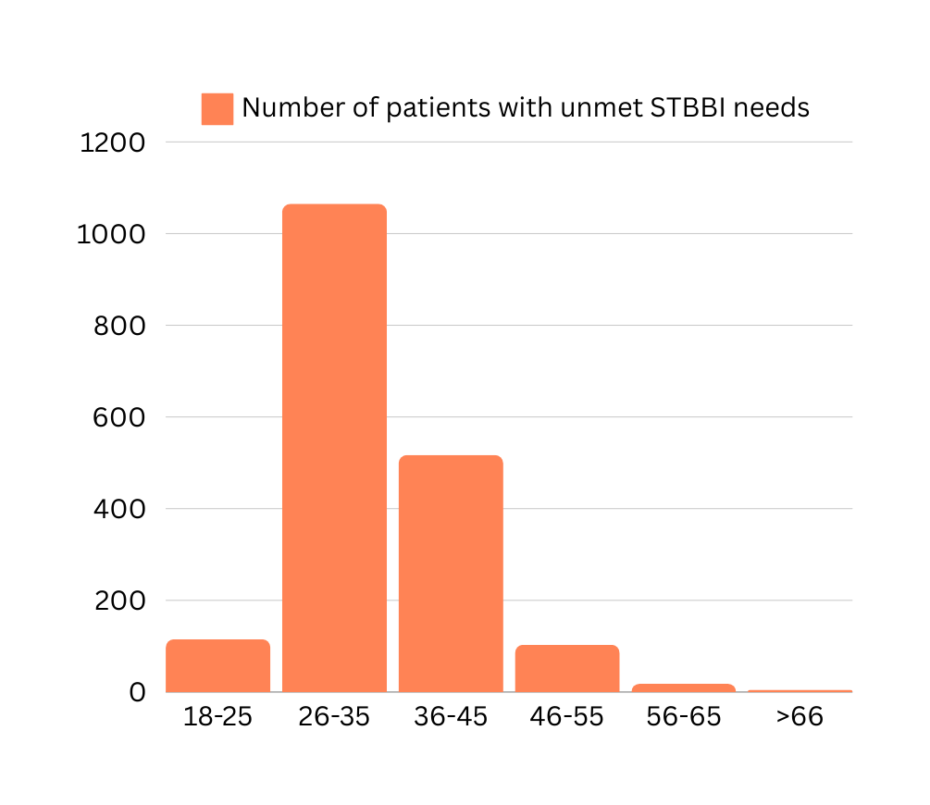
Unmet STBBI Needs: Age
Number of individuals
@myhqtoronto | hqtoronto.ca | hqtoronto.ca/donate

Slide 25

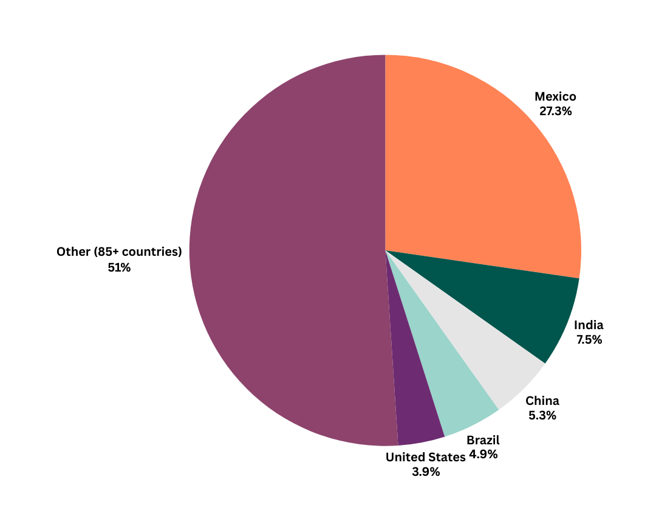
Unmet STBBI Needs: Country of Origin
Other countries of origin (individuals): Ukraine, Saudi Arabia, Peru, Barbados, Thailand, Cyprus, Hungary, Venezuela, Germany, South Korea, Spain, France, Uganda, Nigeria, Guyana, Ghana, Panama, Australia, Jamaica, Pakistan
@myhqtoronto | hqtoronto.ca | hqtoronto.ca/donate

Slide 26
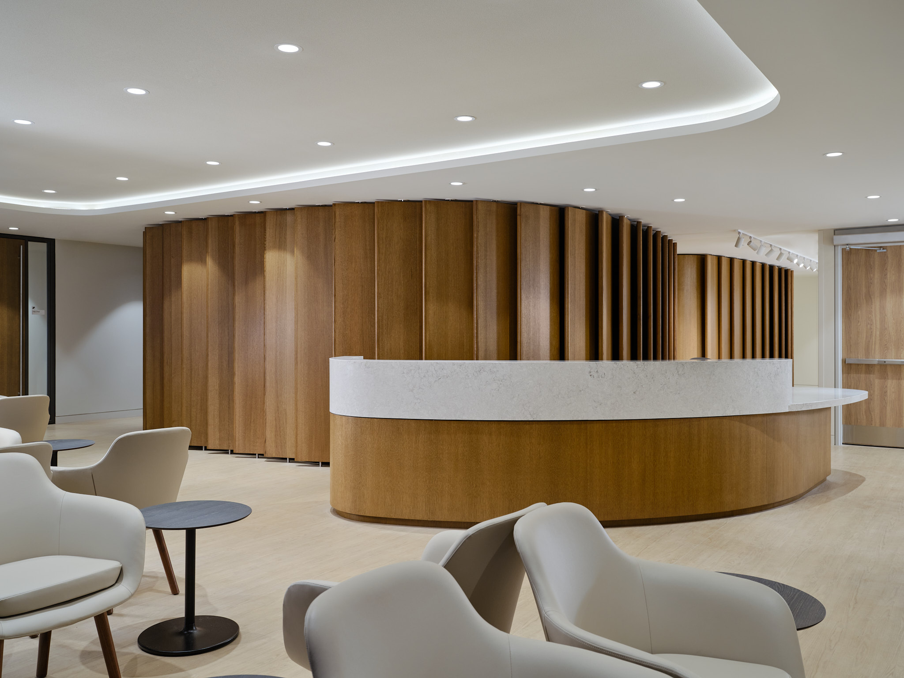
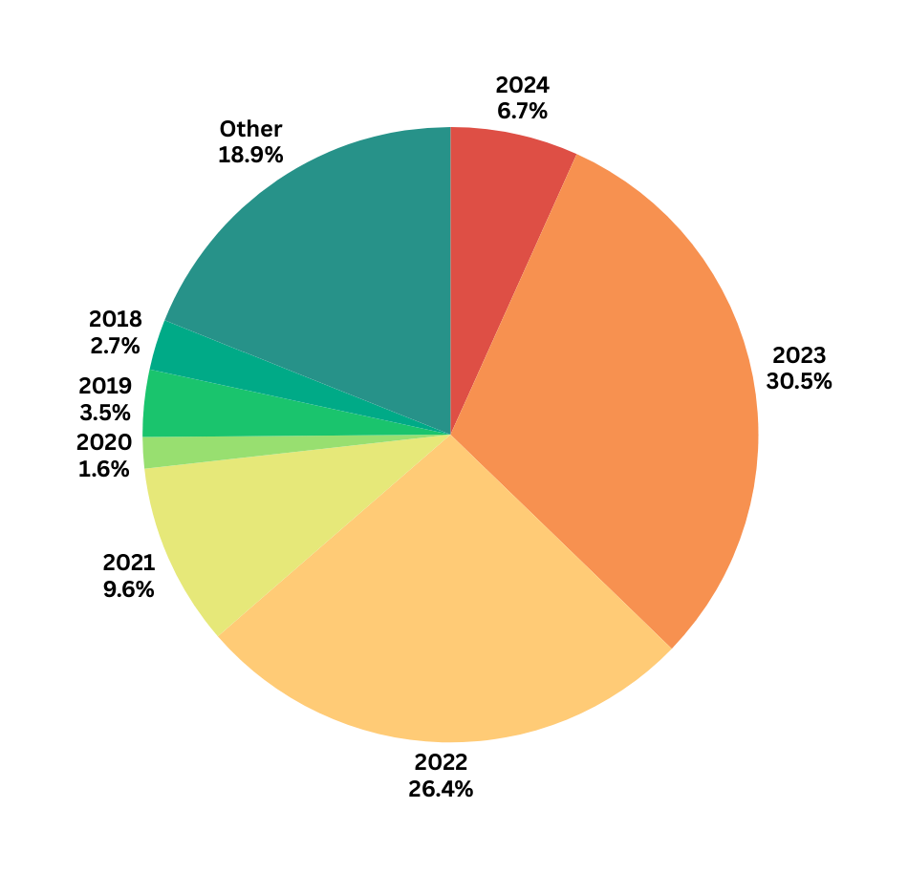
Unmet STBBI Needs: Year of Arrival in Canada
@myhqtoronto | hqtoronto.ca | hqtoronto.ca/donate

Slide 27

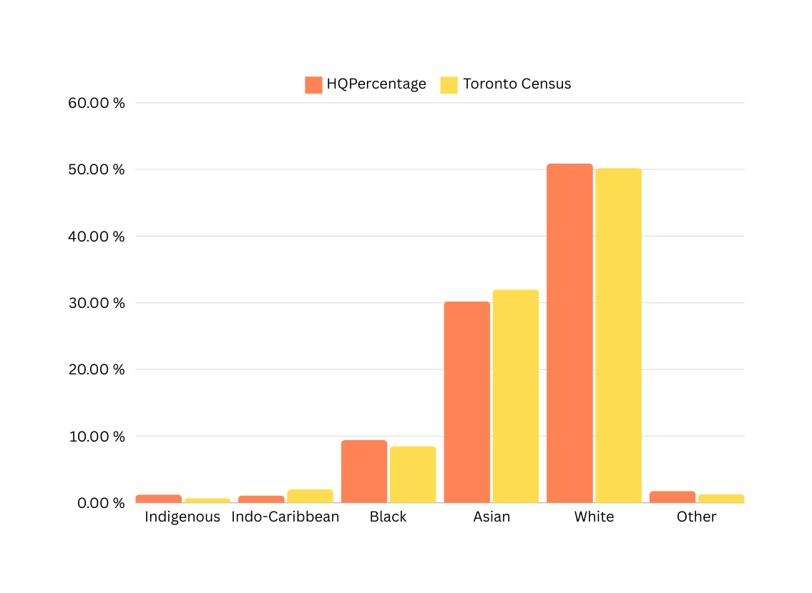
Ethnicity, by individual
Corrected for increases in Latinx, Mixed and Middle Eastern individuals by removing over-represented groups then re-calculating percentages
@myhqtoronto | hqtoronto.ca | hqtoronto.ca/donate

Slide 28
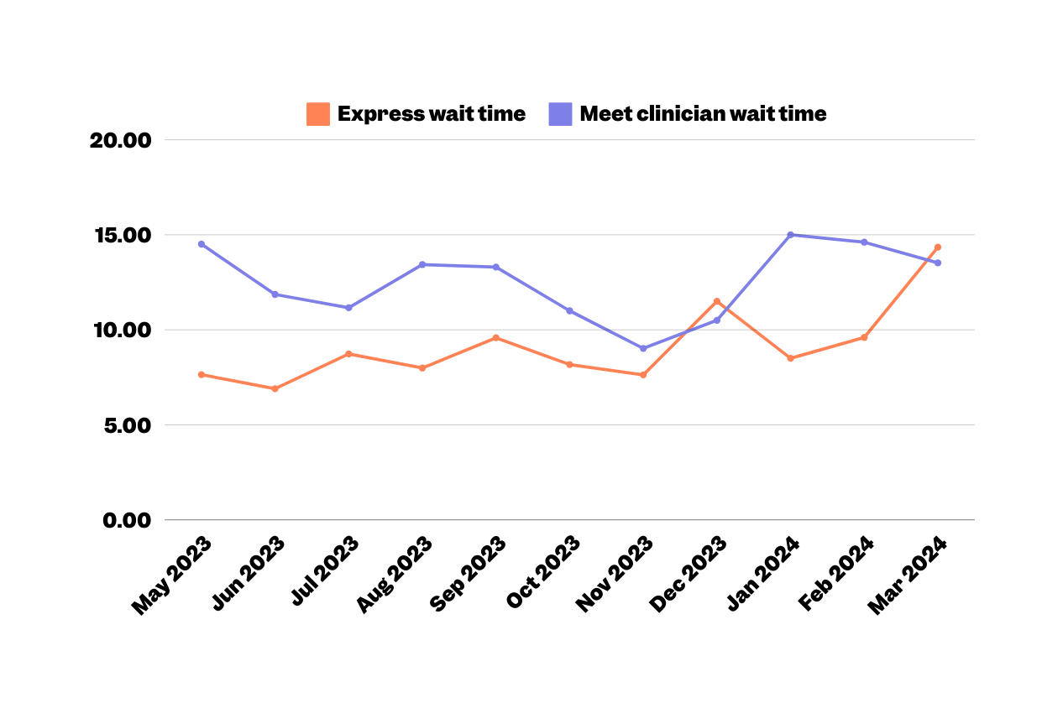
Outcome PREM -Visit Time
May - January 2024
DRAFT
Duration (minutes)
@myhqtoronto | hqtoronto.ca | hqtoronto.ca/donate

Slide 29

“Me siento muy afortunado de tener cerca a una clinica tan vanguardista como HQ”
"I feel very fortunate to have a state-of-the-art clinic like HQ nearby."
- Anonymous survey 2
“I was very happy with all the caring and attention. Great job guys"
- Anonymous survey 3
@myhqtoronto | hqtoronto.ca | hqtoronto.ca/donate

Slide 30
Patient Experience
March 2022 to January 2024
 | Score (out of 5) 599 surveys out of 28,939 sent Response rate 2.1% | % Negative reviews 😠(1/5) 🙁(2/5) | % Neutral reviews 😐(3/5)
Overall Experience | 4.81 / 5 | 2.2% | 1.5%
Efficiency | 4.78 / 5 | 2.5% | 2.2%
Welcoming | 4.78 / 5 | 2.7% | 1.7%
Recommend to a friend | 4.88 / 5 | 1.5% | 0.8%
“I feel completely safe understood and that I can speak freely about my medical needs as a gay man. I have never felt that before in a medical facility.”
- Anonymous survey
@myhqtoronto | hqtoronto.ca | hqtoronto.ca/donate

Slide 31
Patient Experience
December 2023
 | Score (out of 5) 55 surveys out of 2,550 sent Response rate 2.2% | % Negative reviews 😠(1/5) 🙁(2/5) | % Neutral reviews 😐(3/5)
Overall Experience | 4.84 / 5 | 1.8% | 1.8%
Efficiency | 4.89 / 5 | 1.8% | 0%
Welcoming | 4.80 / 5 | 3.6% | 0%
Recommend to a friend | 4.90 / 5 | 1.8% | 0%
"Pienso que en verdad fue un ecxelente servicio, muy amables y me atendieron rapido"
I think it was truly excellent service, very kind, and they attended to me quickly.
- Anonymous survey
@myhqtoronto | hqtoronto.ca | hqtoronto.ca/donate

Slide 32
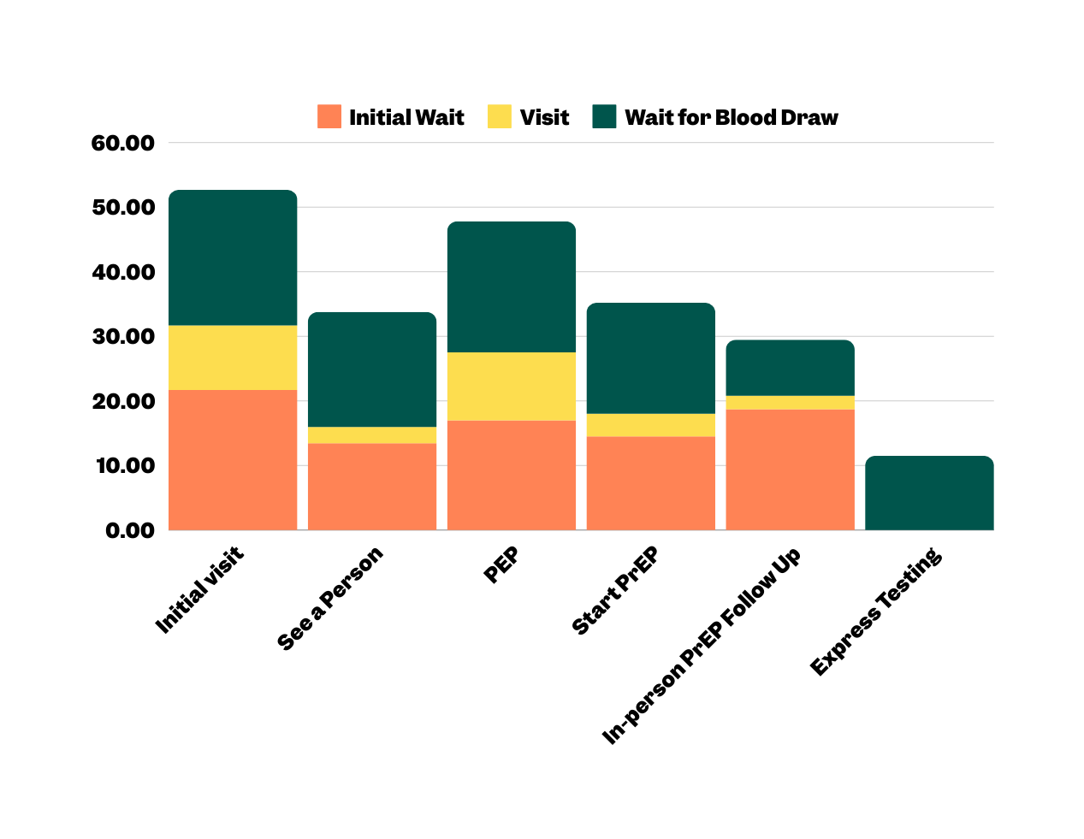
Outcome PREM -Visit Time
May - January 2024
Duration (minutes)
@myhqtoronto | hqtoronto.ca | hqtoronto.ca/donate

Slide 33

J’ai une excellente apprécions l’endroit et moderne et propre les toilettes sont futuriste et le personnel est professionnel c’est une merveilleuse addition pour la communauté gay
"I have an excellent appreciation for the place; it's modern and clean, the toilets are futuristic, and the staff is professional. It's a wonderful addition to the gay community."
- Anonymous survey 4
@myhqtoronto | hqtoronto.ca | hqtoronto.ca/donate
- Anonymous survey 3

Slide 34

Delivering care efficiently and economically
@myhqtoronto | hqtoronto.ca | hqtoronto.ca/donate

Slide 35

“The nurse was ... amazing.
Calmed me right down knew I was going through it and I couldn’t ask for better care”
- Anonymous survey regarding HIV Care
@myhqtoronto | hqtoronto.ca | hqtoronto.ca/donate

Slide 36
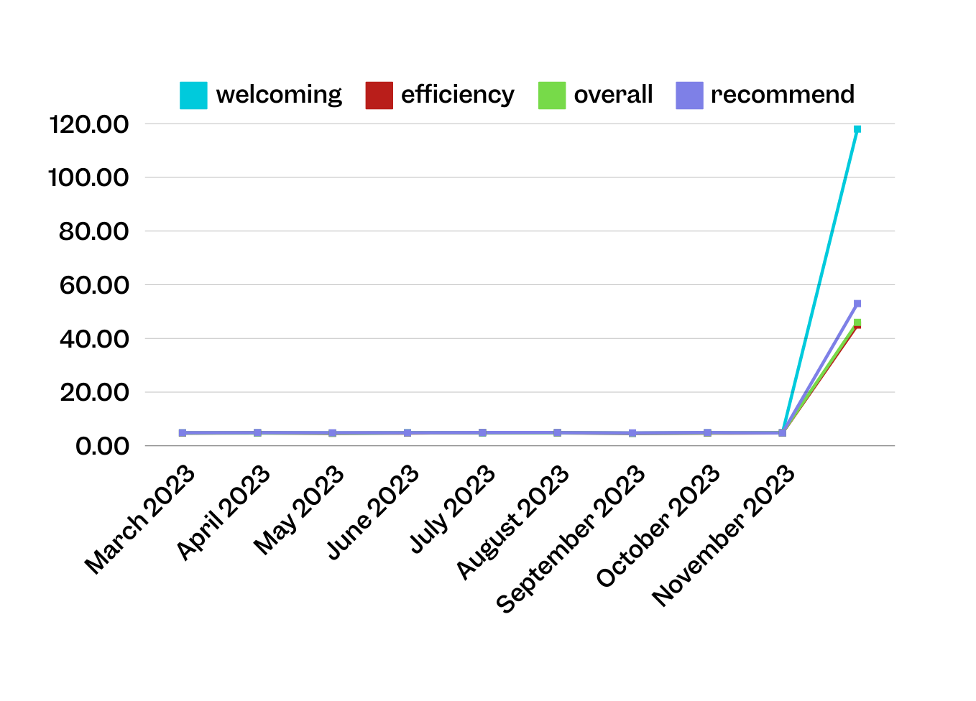
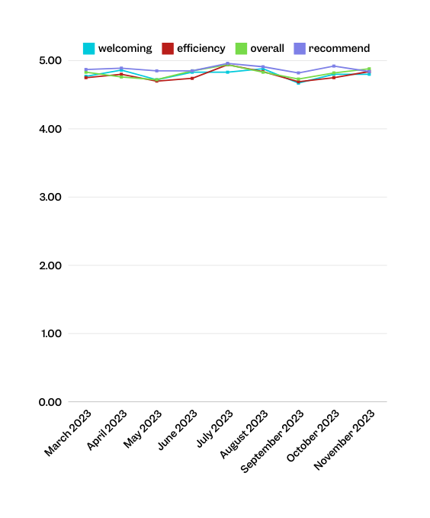

Patient Experience
March 2022 to January 2024
n
118 | 45 | 46 | 53 | 48 | 64 | 51 | 61 | 25
@myhqtoronto | hqtoronto.ca | hqtoronto.ca/donate
10

Slide 37
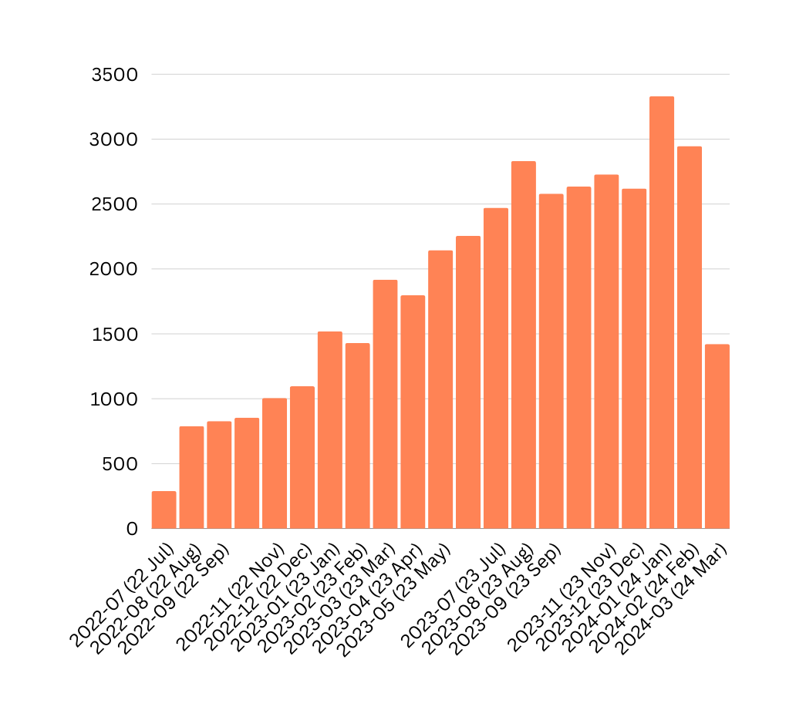

Total Visits to HQ
July 2022 to March 2024
4,725 visits in 2022
27,025 visits in 2023
7,699 visits in 2024

Slide 38

Outcome PREM -Visit Time
May - January 2024
DRAFT
Duration (minutes)
12

Slide 39
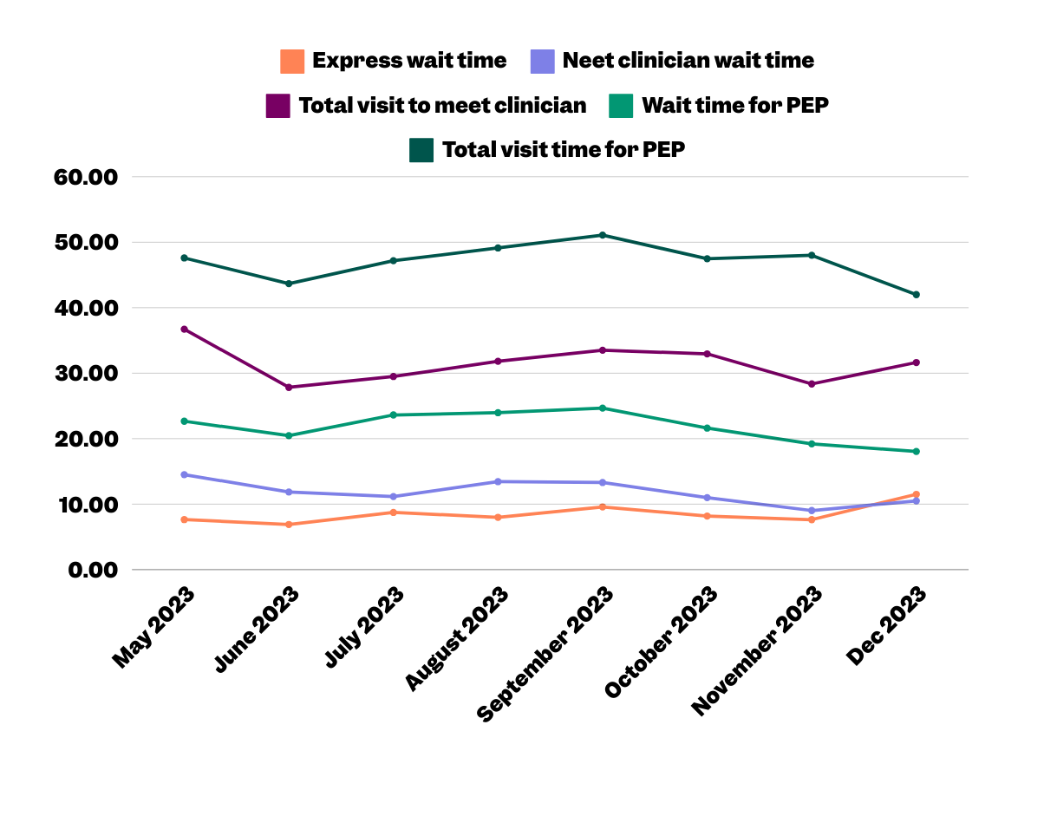
Outcome PREM -Visit Time
May - January 2024
DRAFT
Duration (minutes)
12

Slide 40
Testing this new object thing
October 09, 2024
It looks greats let's see if it works!!!
Blablablablabla22222

Slide 41
Second test being done
This is a second slide template

Slide 42

Third test being done
This is a function that uses Title, Text and a side image

Slide 43
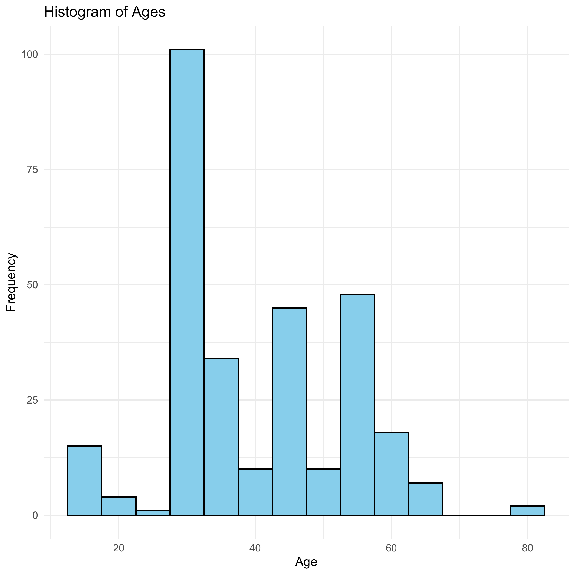
Histogram of Ages
04,0000 in 2024

Slide 44
Histogram of Ages
4,725 visits in 2022 27,025 visits in 2023 7,699 visits in 2024

Slide 45
Histogram of Ages
04,0000 in 2024

Slide 46

Histogram of Ages
04,0000 in 2024

Slide 47
First vs Return July 2023 - June 2024
04,0000 in 2024

Slide 48
First vs Return July 2023 - June 2024
04,725 visits in 2022 27,025 visits in 2023 18,986 visits in 2024

